Slide 1
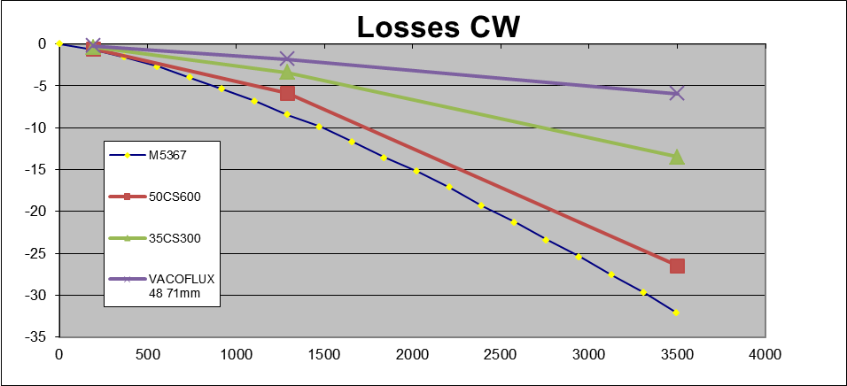
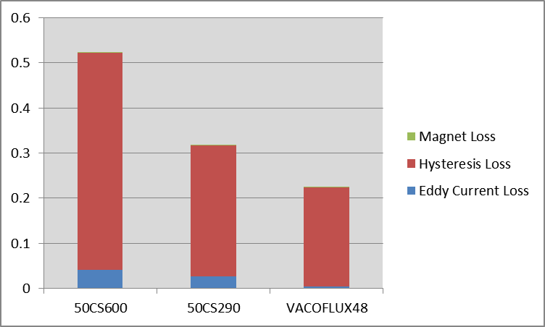
Reduction of Motor Friction
177 | Power Pack | Low friction stator material for motors | PP
Point of
Interest
Finite Element
Models
Measurements
Data Collected from Samples
Simulation Results for 9s6p (K2XX)
26 mNm
Core Loss (Watts) / Friction at 190 RPM
16 mNm
11 mNm
Reduced by 43%~46%
Reduced by ~40%

Slide 2
Reduction of Motor Friction-contd.
Motor Friction is about 40% of the total System Friction
Reduction in friction w/ low core loss material
50cs290 has about 52% lower loss than 50cs600
Motors with 50cs290 showed about 40~45% reduced friction at low speed
No need for reducing lamination thickness
Cost of lamination steel (Si- steel) is a function of core loss
Minimum changes in tooling life and material cost
53mm motor (27/6 shed) incur an increase in cost of $1.40
Motor piece price impact will need to be quoted on program to program basis as there could be some other associated costs (heat treat difference, error proofing, gross/net weight)
Other exotic material (Co-steel, Ni-steel etc.)
Very expensive material ??
Motor needs to be resized
Lighter and Smaller Machine (~0.5Kg less and Stator OD~76mm) possible
Tooling life and other processing might change

Slide 3
Reduction of Motor Friction-contd.
Motivation score – 6
On Track – Motor level study completed
Status - Green
11/19/2015 Updated to Neal
Neal,
The motor group proposed and provided the sample for low friction motor. This is a pure physics based engineering work and I believe the motor group's work is done. Now, if the system or any pursuit group want to try the motor they can do it. The overall friction that includes a big contribution from the gear needs to be assessed to know if it meets the low friction target. This totally depends on the system/pursuit team and we dont have any data regarding that. I'm not sure what else we need to update to the pursuit team. My last update to the tech meeting had all our study completed with cost and test data at motor level.
Regards,

